Slide 1
Generalised least squares
Alejandro Ordonez
Assistant Professor - Department of Biology
Section for Ecoinformatics & Biodiversity
Center for Biodiversity Dynamics in a Changing World (BIOCHANGE)

Slide 2
mixed effect models What we will talk about today
The basics of generalises Least Squares – the mathematical principle
Dealing with Heteroscedasticity – Solving non equal variance
Modelling the model variance– Solving non-equal variances
Autocorrelation– Solving non-independence
Model selection – Combing ML and RMEL

Slide 3
Any questions?
Ready to start?

Slide 4
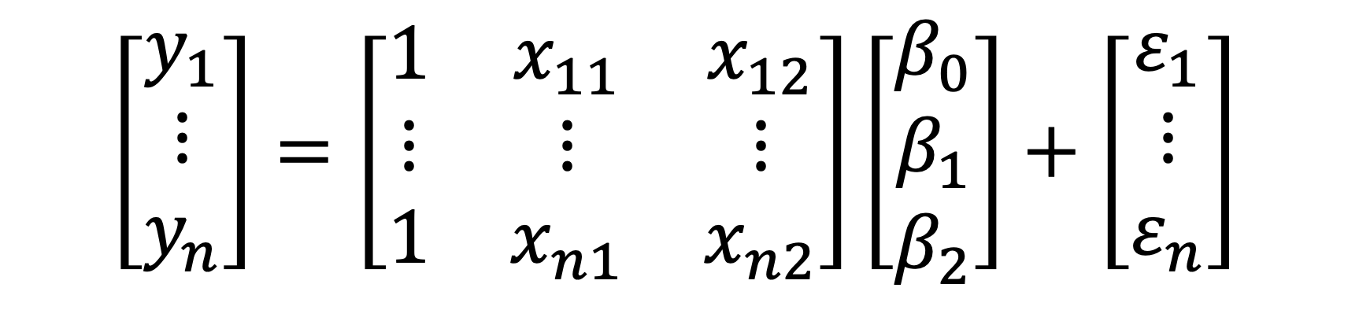
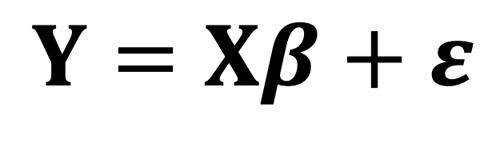
A General Linear Model
$$Y=Xβ+ε$$
$$\left[\begin{matrix}y_{1} \\ ⋮ \\ y_{n}\end{matrix}\right]=\left[\begin{matrix}1 & x_{11} & x_{12} \\ ⋮ & ⋮ & ⋮ \\ 1 & x_{n1} & x_{n2}\end{matrix}\right]\left[\begin{matrix}β_{0} \\ β_{1} \\ β_{2}\end{matrix}\right]+\left[\begin{matrix}ε_{1} \\ ⋮ \\ ε_{n}\end{matrix}\right]$$
Fixed part
Error part

Slide 5
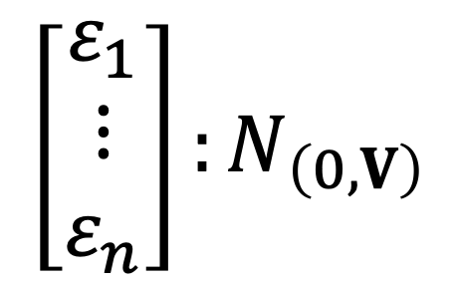
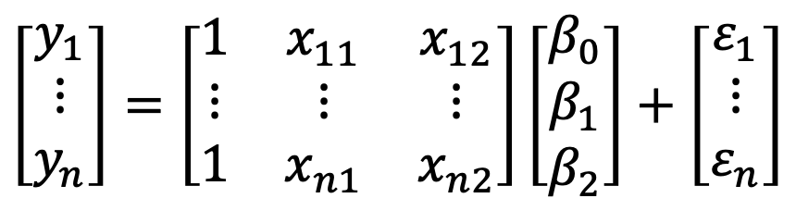
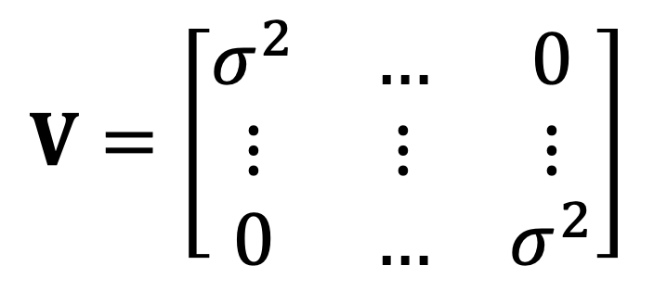
A General Linear Model
Random part
$$\left[\begin{matrix}y_{1} \\ ⋮ \\ y_{n}\end{matrix}\right]=\left[\begin{matrix}1 & x_{11} & x_{12} \\ ⋮ & ⋮ & ⋮ \\ 1 & x_{n1} & x_{n2}\end{matrix}\right]\left[\begin{matrix}β_{0} \\ β_{1} \\ β_{2}\end{matrix}\right]+\left[\begin{matrix}ε_{1} \\ ⋮ \\ ε_{n}\end{matrix}\right]$$
Normally distributed errors
Homogeneity of variances
$$\left[\begin{matrix}ε_{1} \\ ⋮ \\ ε_{n}\end{matrix}\right]:N_{\left(0,V\right)}$$
$$V=\left[\begin{matrix}σ^{2} & … & 0 \\ ⋮ & ⋮ & ⋮ \\ 0 & … & σ^{2}\end{matrix}\right]$$
Variance-covariance matrix

Slide 6
Violating the assumptions of a General Linear Model
The variance of error terms is not similar across the independent variable(s)
Heteroscedasticity
What problem is visualised here?
How can you see that problem in these figures?

Slide 7
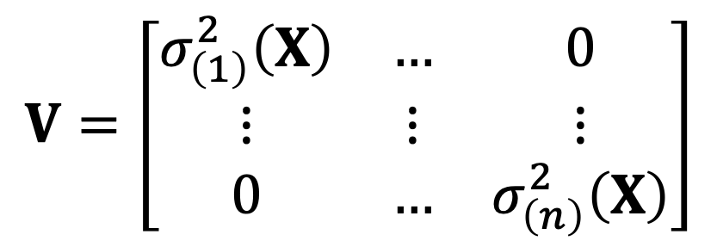
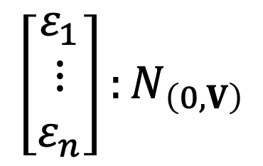
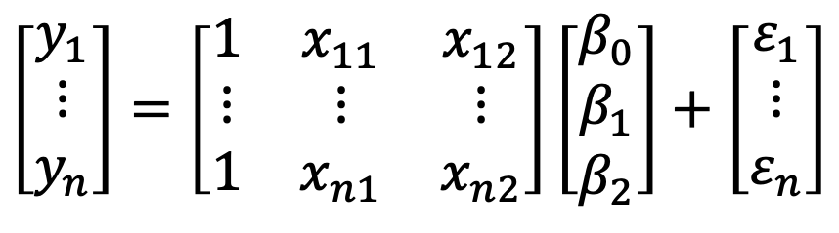
Violating the homogeneity of variances assumption
Random part
$$\left[\begin{matrix}y_{1} \\ ⋮ \\ y_{n}\end{matrix}\right]=\left[\begin{matrix}1 & x_{11} & x_{12} \\ ⋮ & ⋮ & ⋮ \\ 1 & x_{n1} & x_{n2}\end{matrix}\right]\left[\begin{matrix}β_{0} \\ β_{1} \\ β_{2}\end{matrix}\right]+\left[\begin{matrix}ε_{1} \\ ⋮ \\ ε_{n}\end{matrix}\right]$$
Variances are not equal across observations
Normally distributed errors
Variance heterogeneity
$$V=\left[\begin{matrix}σ_{\left(1\right)}^{2}\left(X\right) & … & 0 \\ ⋮ & ⋮ & ⋮ \\ 0 & … & σ_{\left(n\right)}^{2}\left(X\right)\end{matrix}\right]$$
$$\left[\begin{matrix}ε_{1} \\ ⋮ \\ ε_{n}\end{matrix}\right]:N_{\left(0,V\right)}$$

Slide 8
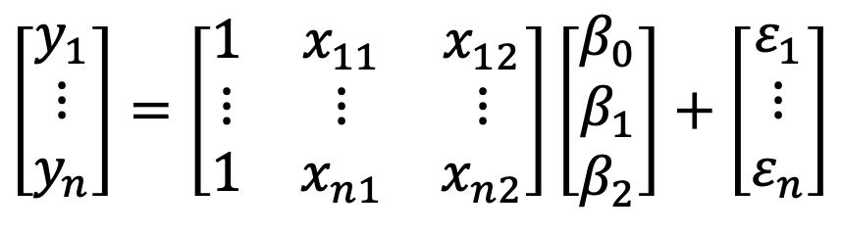
Violating the homogeneity of variances assumption
Random part
$$\left[\begin{matrix}y_{1} \\ ⋮ \\ y_{n}\end{matrix}\right]=\left[\begin{matrix}1 & x_{11} & x_{12} \\ ⋮ & ⋮ & ⋮ \\ 1 & x_{n1} & x_{n2}\end{matrix}\right]\left[\begin{matrix}β_{0} \\ β_{1} \\ β_{2}\end{matrix}\right]+\left[\begin{matrix}ε_{1} \\ ⋮ \\ ε_{n}\end{matrix}\right]$$
However observations are still independent
Normally distributed errors
Variance heterogeneity
$$V=\left[\begin{matrix}σ_{\left(1\right)}^{2}\left(X\right) & … & 0 \\ ⋮ & ⋮ & ⋮ \\ 0 & … & σ_{\left(n\right)}^{2}\left(X\right)\end{matrix}\right]$$
$$\left[\begin{matrix}ε_{1} \\ ⋮ \\ ε_{n}\end{matrix}\right]:N_{\left(0,V\right)}$$

Slide 9
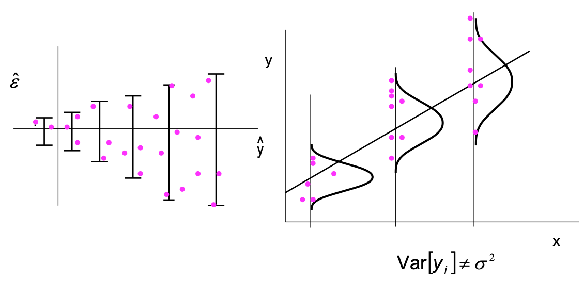
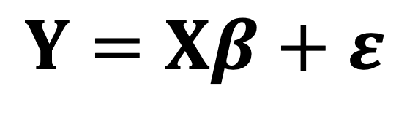
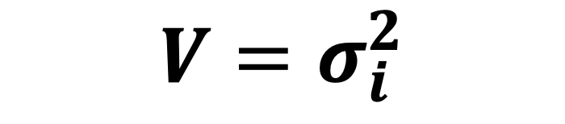
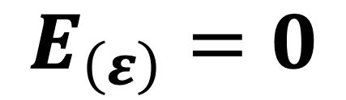
Generalised Least Squares
$$Y=Xβ+ε$$
Variance changes between observations
$$V=σ_{i}^{2}$$
Mean is Zero
$$E_{\left(ε\right)}=0$$

Slide 10
Modeling variances in R Gls not lm models
Remember that in basic linear models parameters are estimated using Ordinary least squares.
But..
As we move to model the variance we a need a method of estimation that:
Model the fixed effects of the predictors
Accounts for structure in the error term → how the variance changes!
Generalised Least Squares (GLS) is a method of estimation that allows accounting for structure in the error term

Slide 11
Modeling variances in R with GLS
Name of the function in R | What does it do?
VarIdent | Different variances per stratum
VarFixed | Fixed variance
VarPower | Power of the variance covariate
VarExp | Exponential of the variance covariate
VarConstPower | Constant plus power of the variance covariate
VarComb | A combination of variance functions
gls (y ~ x ,
weights = VAR.Fn
method = “ML/REML”)
The syntax is almost the same as an lm but You can specify a description of the within-group heteroscedasticity structure as weights

Slide 12
Modeling variances in R with GLS
gls (y ~ x ,
weights = VAR.Fn
method = “ML/REML”)
The general approach
Gaussian errors
MASS::glmPQL (y ~ x ,
weights = VAR.Fn
family = “poisson”)
The generalised approach
Gaussian/binomial/Poisson errors

Slide 13
So far so good?
Any questions?
Ready to move on?

Slide 14
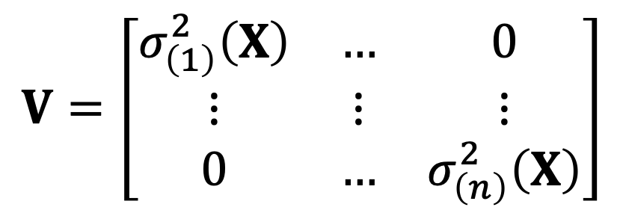
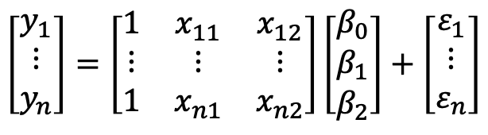
How to deal with unequal variances
Build a model to describe how the variability changes as a function of the data
$$\left[\begin{matrix}y_{1} \\ ⋮ \\ y_{n}\end{matrix}\right]=\left[\begin{matrix}1 & x_{11} & x_{12} \\ ⋮ & ⋮ & ⋮ \\ 1 & x_{n1} & x_{n2}\end{matrix}\right]\left[\begin{matrix}β_{0} \\ β_{1} \\ β_{2}\end{matrix}\right]+\left[\begin{matrix}ε_{1} \\ ⋮ \\ ε_{n}\end{matrix}\right]$$
Variance heterogeneity
$$V=\left[\begin{matrix}σ_{\left(1\right)}^{2}\left(X\right) & … & 0 \\ ⋮ & ⋮ & ⋮ \\ 0 & … & σ_{\left(n\right)}^{2}\left(X\right)\end{matrix}\right]$$
R does this by adding a weights to the variance of each observation

Slide 15
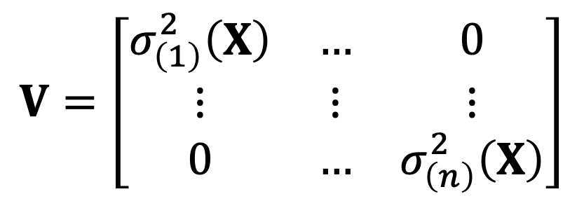
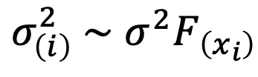
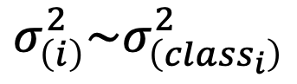
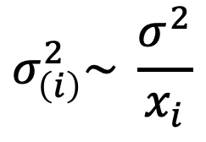
How to deal with unequal variances
Weights are included by defining a function to describe the change in variance between observations
$$\left[\begin{matrix}y_{1} \\ ⋮ \\ y_{n}\end{matrix}\right]=\left[\begin{matrix}1 & x_{11} & x_{12} \\ ⋮ & ⋮ & ⋮ \\ 1 & x_{n1} & x_{n2}\end{matrix}\right]\left[\begin{matrix}β_{0} \\ β_{1} \\ β_{2}\end{matrix}\right]+\left[\begin{matrix}ε_{1} \\ ⋮ \\ ε_{n}\end{matrix}\right]$$
Variance depend on a category
$$σ_{\left(i\right)}^{2}\sim σ_{\left({class}_{i}\right)}^{2}$$
Variance heterogeneity
$$V=\left[\begin{matrix}σ_{\left(1\right)}^{2}\left(X\right) & … & 0 \\ ⋮ & ⋮ & ⋮ \\ 0 & … & σ_{\left(n\right)}^{2}\left(X\right)\end{matrix}\right]$$
Variance proportional to a variance covariate
$$σ_{\left(i\right)}^{2}\sim \frac{σ^{2}}{x_{i}}$$
Variance as a function of a variance covariate
$σ_{\left(i\right)}^{2} \sim$ ${σ^{2}F}_{\left(x_{i}\right)}$

Slide 16
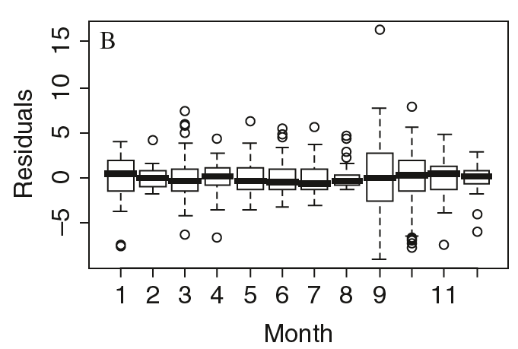
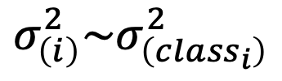
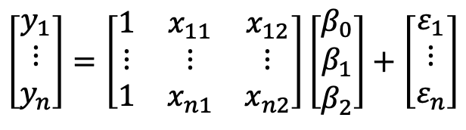
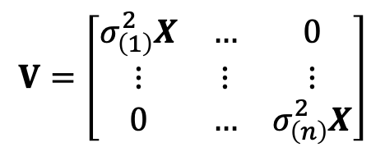
Different variances per stratum
Variance depend on a category
$$σ_{\left(i\right)}^{2}\sim σ_{\left({class}_{i}\right)}^{2}$$
$$\left[\begin{matrix}y_{1} \\ ⋮ \\ y_{n}\end{matrix}\right]=\left[\begin{matrix}1 & x_{11} & x_{12} \\ ⋮ & ⋮ & ⋮ \\ 1 & x_{n1} & x_{n2}\end{matrix}\right]\left[\begin{matrix}β_{0} \\ β_{1} \\ β_{2}\end{matrix}\right]+\left[\begin{matrix}ε_{1} \\ ⋮ \\ ε_{n}\end{matrix}\right]$$
Here each month was its own variance
Variance heterogeneity
$$V=\left[\begin{matrix}σ_{\left(1\right)}^{2}X & … & 0 \\ ⋮ & ⋮ & ⋮ \\ 0 & … & σ_{\left(n\right)}^{2}X\end{matrix}\right]$$

Slide 17
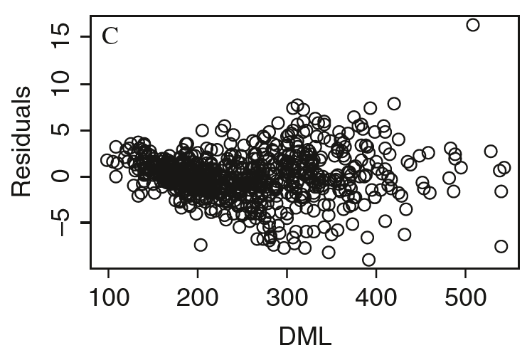
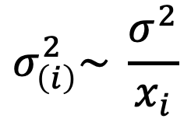
Weighted variances
$$σ_{\left(i\right)}^{2}\sim \frac{σ^{2}}{x_{i}}$$
Variance as a function of a predictor(s)
$$\left[\begin{matrix}y_{1} \\ ⋮ \\ y_{n}\end{matrix}\right]=\left[\begin{matrix}1 & x_{11} & x_{12} \\ ⋮ & ⋮ & ⋮ \\ 1 & x_{n1} & x_{n2}\end{matrix}\right]\left[\begin{matrix}β_{0} \\ β_{1} \\ β_{2}\end{matrix}\right]+\left[\begin{matrix}ε_{1} \\ ⋮ \\ ε_{n}\end{matrix}\right]$$
Changes in variance are proportional to a predictor
Variance heterogeneity
$$V=\left[\begin{matrix}σ_{\left(1\right)}^{2}X & … & 0 \\ ⋮ & ⋮ & ⋮ \\ 0 & … & σ_{\left(n\right)}^{2}X\end{matrix}\right]$$

Slide 18
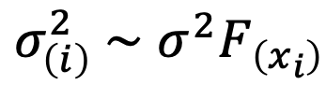
Different variances per stratum
Variance as a function of a variance covariate
$σ_{\left(i\right)}^{2} \sim$ ${σ^{2}F}_{\left(x_{i}\right)}$
$$\left[\begin{matrix}y_{1} \\ ⋮ \\ y_{n}\end{matrix}\right]=\left[\begin{matrix}1 & x_{11} & x_{12} \\ ⋮ & ⋮ & ⋮ \\ 1 & x_{n1} & x_{n2}\end{matrix}\right]\left[\begin{matrix}β_{0} \\ β_{1} \\ β_{2}\end{matrix}\right]+\left[\begin{matrix}ε_{1} \\ ⋮ \\ ε_{n}\end{matrix}\right]$$
Changes in variance are a function of a variance covariate
Variance heterogeneity
$$V=\left[\begin{matrix}σ_{\left(1\right)}^{2}X & … & 0 \\ ⋮ & ⋮ & ⋮ \\ 0 & … & σ_{\left(n\right)}^{2}X\end{matrix}\right]$$

Slide 19
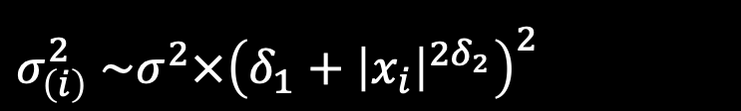
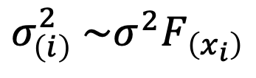
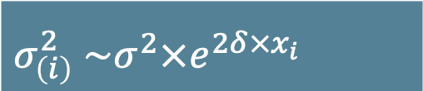
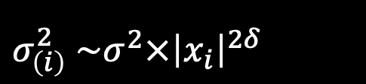
variances As a function
Variance as a function of a variance covariate
$$σ_{\left(i\right)}^{2} \sim σ^{2}F_{\left(x_{i}\right)}$$
$$\left[\begin{matrix}y_{1} \\ ⋮ \\ y_{n}\end{matrix}\right]=\left[\begin{matrix}1 & x_{11} & x_{12} \\ ⋮ & ⋮ & ⋮ \\ 1 & x_{n1} & x_{n2}\end{matrix}\right]\left[\begin{matrix}β_{0} \\ β_{1} \\ β_{2}\end{matrix}\right]+\left[\begin{matrix}ε_{1} \\ ⋮ \\ ε_{n}\end{matrix}\right]$$
Functions can be of different types:
Functions can be summarized as:
Variance heterogeneity
Power Function
$$V=\left[\begin{matrix}σ_{\left(1\right)}^{2}X & … & 0 \\ ⋮ & ⋮ & ⋮ \\ 0 & … & σ_{\left(n\right)}^{2}X\end{matrix}\right]$$
$σ_{\left(i\right)}^{2}$ $\sim σ^{2}×{\left|x_{i}\right|}^{2δ}$
Exponential Function
$σ_{\left(i\right)}^{2}$ $\sim σ^{2}×e^{2δ×x_{i}}$
Constant + Power Function
$σ_{\left(i\right)}^{2}$ $\sim σ^{2}×{\left(δ_{1}+{\left|x_{i}\right|}^{2δ_{2}}\right)}^{2}$

Slide 20
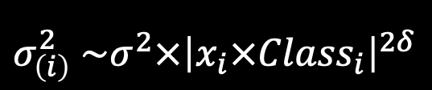
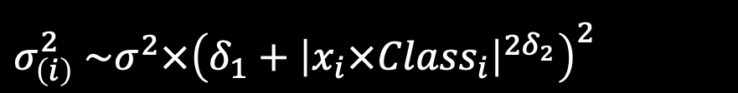
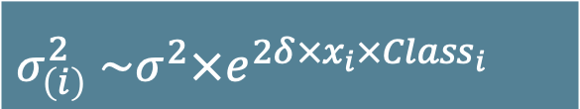
variances As a function
$$\left[\begin{matrix}y_{1} \\ ⋮ \\ y_{n}\end{matrix}\right]=\left[\begin{matrix}1 & x_{11} & x_{12} \\ ⋮ & ⋮ & ⋮ \\ 1 & x_{n1} & x_{n2}\end{matrix}\right]\left[\begin{matrix}β_{0} \\ β_{1} \\ β_{2}\end{matrix}\right]+\left[\begin{matrix}ε_{1} \\ ⋮ \\ ε_{n}\end{matrix}\right]$$
Functions can combine categorical and continuous variance covariate(s)
Variance heterogeneity
Power Function
$$V=\left[\begin{matrix}σ_{\left(1\right)}^{2}X & … & 0 \\ ⋮ & ⋮ & ⋮ \\ 0 & … & σ_{\left(n\right)}^{2}X\end{matrix}\right]$$
$σ_{\left(i\right)}^{2}$ $\sim σ^{2}×{\left|x_{i}{×Class}_{i}\right|}^{2δ}$
Exponential Function
$σ_{\left(i\right)}^{2}$ $\sim σ^{2}×e^{2δ×x_{i}×{Class}_{i}}$
Constant + Power Function
$σ_{\left(i\right)}^{2}$ $\sim σ^{2}×{\left(δ_{1}+{\left|x_{i}×{Class}_{i}\right|}^{2δ_{2}}\right)}^{2}$

Slide 21
So far so good?
Any questions?
Ready to move on?

Slide 22
Overview of All Variance Structures
Name of the function in R | What does it do?
VarIdent | Different variances per stratum
VarFixed | Fixed variance
VarPower | Power of the variance covariate
VarExp | Exponential of the variance covariate
VarConstPower | Constant plus power of the variance covariate
VarComb | A combination of variance functions
Rather limited – Problematic when Variance-Convariance takes negative Values

Slide 23
Overview of All Variance Structures
Name of the function in R | What does it do?
VarIdent | Different variances per stratum
VarFixed | Fixed variance
VarPower | Power of the variance covariate
VarExp | Exponential of the variance covariate
VarConstPower | Constant plus power of the variance covariate
VarComb | A combination of variance functions
Flexible, but do not use if the variance covariate takes the value of zero

Slide 24
Overview of All Variance Structures
Name of the function in R | What does it do?
VarIdent | Different variances per stratum
VarFixed | Fixed variance
VarPower | Power of the variance covariate
VarExp | Exponential of the variance covariate
VarConstPower | Constant plus power of the variance covariate
VarComb | A combination of variance functions
Flexible, can use if the variance covariate takes the value of zero

Slide 25
So far so good?
Any questions?
Ready to move on?

Slide 26
Mixed Effects Models the problem of independence
Observational/experiments can have:
Spatial-Temporal-Evolutionary proximity
Autocorrelation → removes independence between samples
A nested observational/experimental design
samples taken across different spatial-temporal-taxonomic scales
What does this mean?
Samples have “Pseudoreplication”

Slide 27
Mixed Effects Models (Pseudo)replication
Independent observations of same measurement
What is replication?
What is (Pseudo)replication?
Replicates are not independent (spatial-temporal), or “treatments are truly not replicated”
What is independent?
Independent is when the value of one observation does not affect the value of other observations

Slide 28
Independence of observations
What does it mean?
Objects are sampled only once.
The occurrence of one event doesn't change the probability for another.
Sampling of one observation does not affect the choice of the second observation.
How can we ensure independence of observations?
Sample each object only once.
Make sure that replicates have no relation → if they do, they are repetitions.
Use a fully randomized design!!!

Slide 29
So far so good?
Any questions?
Ready to move on?

Slide 30
Autocorrelation: A more complex variance structure
Time
Space
Species

Slide 31
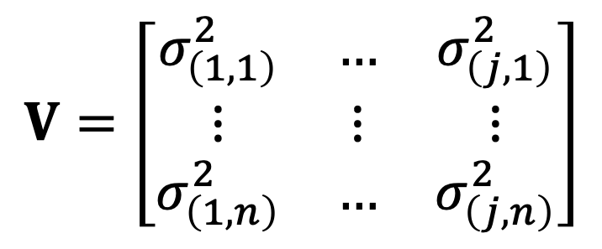
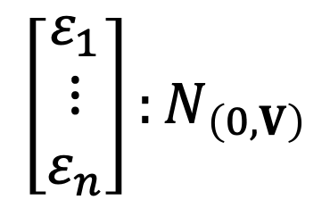
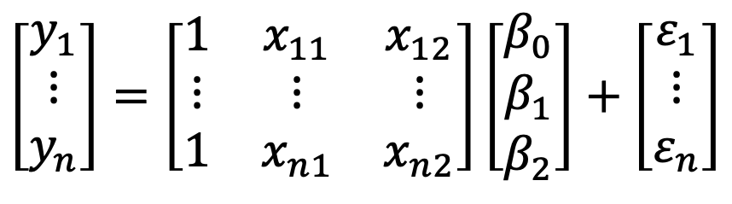
autocorrelation The math behind the model
$$\left[\begin{matrix}y_{1} \\ ⋮ \\ y_{n}\end{matrix}\right]=\left[\begin{matrix}1 & x_{11} & x_{12} \\ ⋮ & ⋮ & ⋮ \\ 1 & x_{n1} & x_{n2}\end{matrix}\right]\left[\begin{matrix}β_{0} \\ β_{1} \\ β_{2}\end{matrix}\right]+\left[\begin{matrix}ε_{1} \\ ⋮ \\ ε_{n}\end{matrix}\right]$$
Random part
Observations are not independent
Normally distributed errors
Variance heterogeneity
$$V=\left[\begin{matrix}σ_{\left(1,1\right)}^{2} & … & σ_{\left(j,1\right)}^{2} \\ ⋮ & ⋮ & ⋮ \\ σ_{\left(1,n\right)}^{2} & … & σ_{\left(j,n\right)}^{2}\end{matrix}\right]$$
$$\left[\begin{matrix}ε_{1} \\ ⋮ \\ ε_{n}\end{matrix}\right]:N_{\left(0,V\right)}$$
Variances are not equal across observations

Slide 32
Modeling Correlations in R with GLS
gls (y ~ x ,
correlation = Cor.Fn,
method = “ML/REML”)
Name of the function in R | What does it do?
corAR1 | autoregressive process of order 1
corARMA | autoregressive moving average process
corExp | exponential spatial correlation
corGaus | Gaussian spatial correlation
corLin | linear spatial correlation
corRatio | Rational quadratics spatial correlation
corSpher | spherical spatial correlation
corBrownian | Brownian motion mode
corPagel | The covariance matrix defined Freckelton et al. (2002)
MASS::glmmPQL (y ~ x ,
correlation = Cor.Fn,
family = “poisson”)
The syntax is almost the same as an lm but You can specify a description of the correlation between observations as a correlation

Slide 33
So far so good?
Any questions?
Ready to move on?

Slide 34
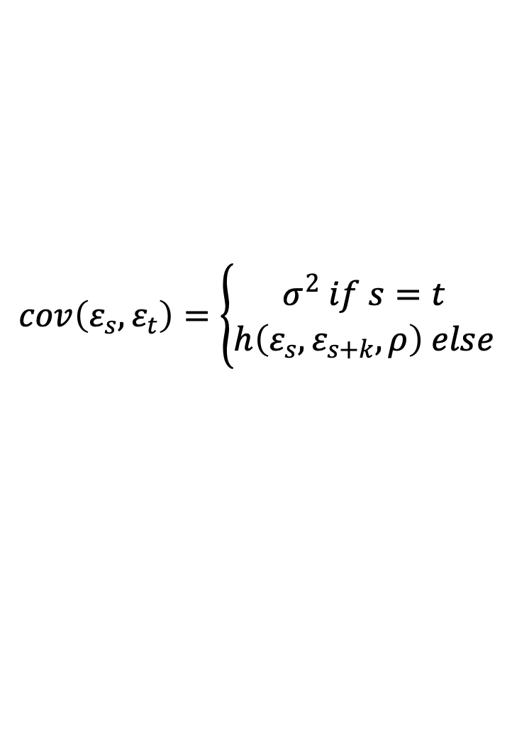
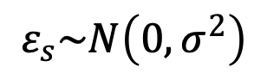
Temporal autocorrelation The math behind the model
$$ε_{s}\sim N\left(0,σ^{2}\right)$$
$$cov\left(ε_{s},ε_{t}\right)=\left\{\begin{aligned}σ^{2} if s=t \\ h\left(ε_{s},ε_{s+k},ρ\right) else\end{aligned}\right.$$
Correlation function
function that measures the spatial dependence between two sites
We assume stationarity
Correlation between the residuals ε_{s} and ε_{t} only depends on their time difference (s – t)
The goal
Find the best optimal parameterisation of the correlation function

Slide 35
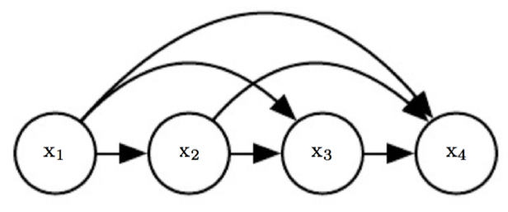
Temporal autocorrelation The temporal case
Output variable depends linearly on its own previous values
That means :
To estimate the response at time t_{n} we need to know the value/errors of the Predictor Xi at that time t_{n} AND the state of the response at time t_{n-1}

Slide 36
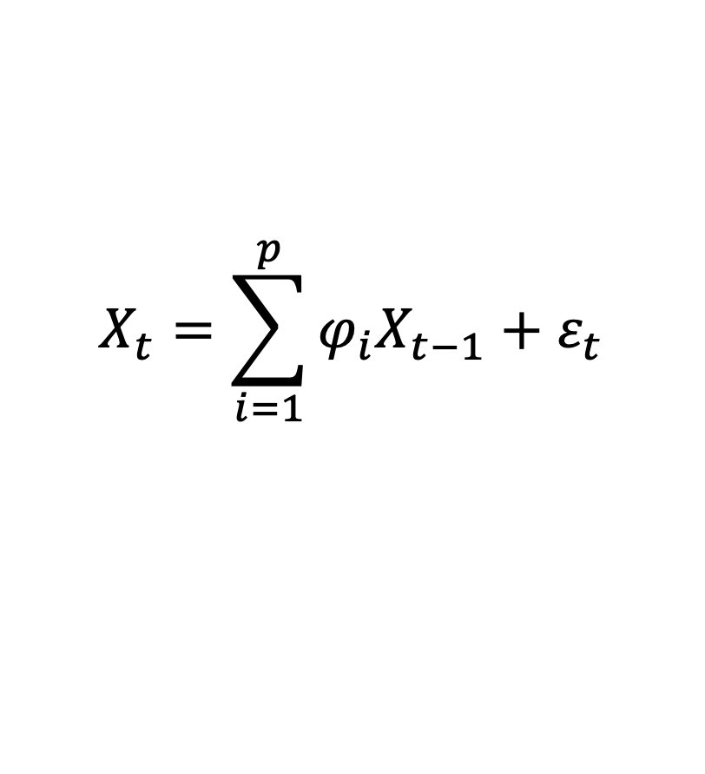
Temporal autocorrelation AUTOREGRESSIVE MODEL
If we use the preceding value, we call this an Autoregressive model
Autoregression = regression of the variable against itself.
$$X_{t}=\sum_{i=1}^{p}{φ_{i}X_{t−1}+ε_{t}}$$
Output variable depends linearly on its own previous values

Slide 37
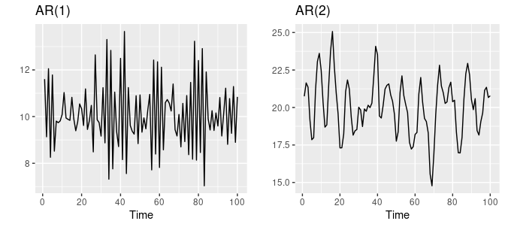
Temporal autocorrelation AUTOREGRESSIVE MODEL
AR(1) process is one in which the current value is based on the immediately preceding value
AR(2) process is one in which the current value is based on the previous two values
The correlation is uni-directional as past events afects future ones, not the other way

Slide 38
Temporal autocorrelation AUTOREGRESSIVE MODEL
AR(1) process is one in which the current value is based on the immediately preceding value
AR(2) process is one in which the current value is based on the previous two values
AR(1)? AR(2)?... AR(p)?
Select via likelihood test/AIC
The correlation is uni-directional as past events afects future ones, not the other way

Slide 39
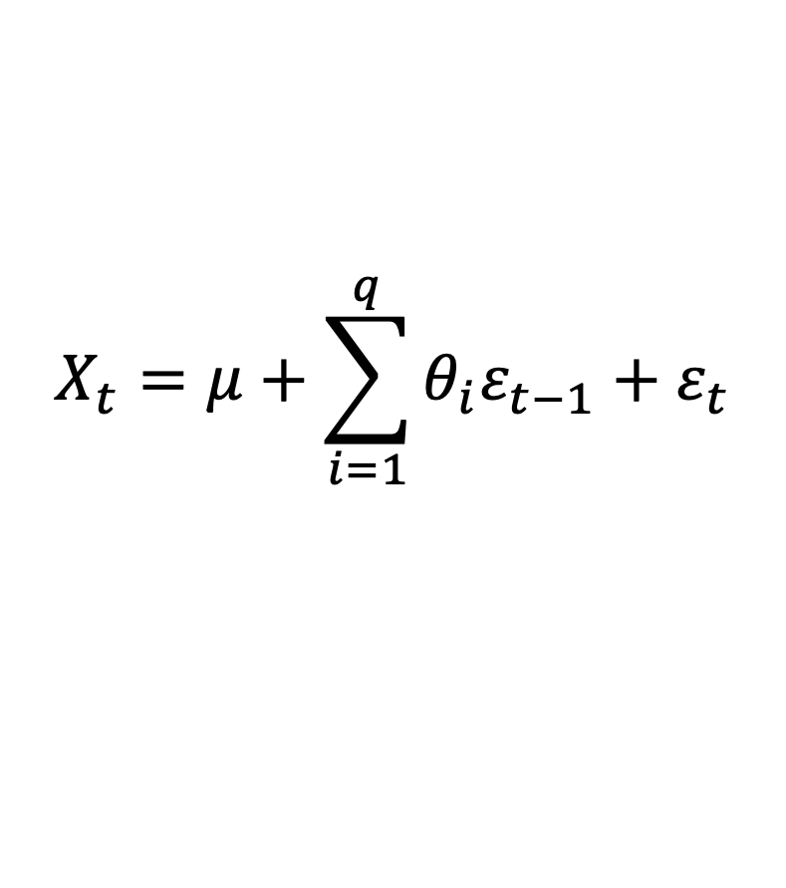
Temporal autocorrelation MOVING AVERAGE MODEL
If we use the preceding error(s), we call this a Moving average model
Error defines the difference form the time series mean.
$$X_{t}=μ+\sum_{i=1}^{q}{θ_{i}ε_{t−1}+ε_{t}}$$
Output variable depends linearly on its own previous values

Slide 40
TEMPORAL autocorrelation autoregresive + movig average
Autoregresive
Forcast based on the observations
ARMA
AutoRegressive
Moving Average
Movig average
Forcast based on the Errors

Slide 41
Temporal autocorrelation R – implementation
autoregressive parameters
Covariate with time
corAR1(value, form)
corARMA(value,form, p, q)
autoregressive &
moving average parameters
autoregressive and moving average order
Covariate with time

Slide 42
So far so good?
Any questions?
Ready to move on?

Slide 43
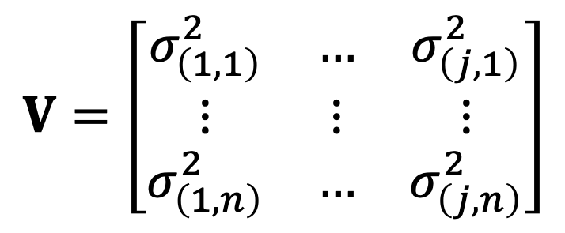
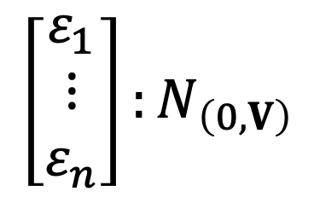
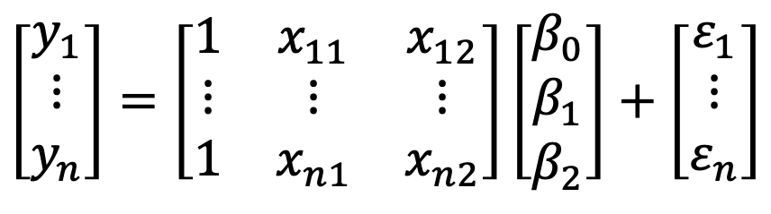
Spatial autocorrelation The math behind the model
Random part
$$\left[\begin{matrix}y_{1} \\ ⋮ \\ y_{n}\end{matrix}\right]=\left[\begin{matrix}1 & x_{11} & x_{12} \\ ⋮ & ⋮ & ⋮ \\ 1 & x_{n1} & x_{n2}\end{matrix}\right]\left[\begin{matrix}β_{0} \\ β_{1} \\ β_{2}\end{matrix}\right]+\left[\begin{matrix}ε_{1} \\ ⋮ \\ ε_{n}\end{matrix}\right]$$
Observations are not independent
Normally distributed errors
Variance heterogeneity
$$V=\left[\begin{matrix}σ_{\left(1,1\right)}^{2} & … & σ_{\left(j,1\right)}^{2} \\ ⋮ & ⋮ & ⋮ \\ σ_{\left(1,n\right)}^{2} & … & σ_{\left(j,n\right)}^{2}\end{matrix}\right]$$
$$\left[\begin{matrix}ε_{1} \\ ⋮ \\ ε_{n}\end{matrix}\right]:N_{\left(0,V\right)}$$
Variances are not equal across observations

Slide 44
Spatial autocorrelation Fitting correlation functions
Exponential correlation
corExp
Spherical correlation
corSpher
Linear correlation
corLin
Gaussian correlation
corGaus
Rational quadratic correlation
corRatio

Slide 45
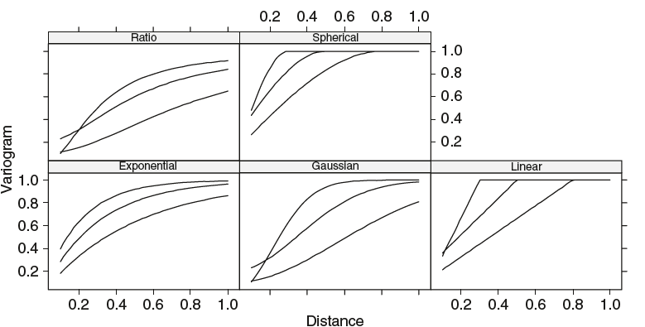
Spatial autocorrelation Fitting correlation functions
Variograms are measures the spatial dependence between two sites

Slide 46
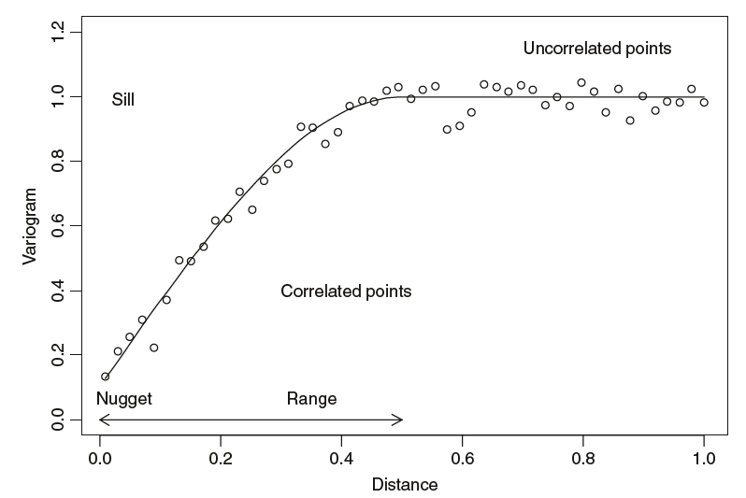
Spatial autocorrelation Fitting correlation functions
sill ➔ the asymptotic value
nugget ➔ the y-value when the distance is 0.
range ➔ the distance where the sill occurs

Slide 47
Spatial autocorrelation R – implementation
corSpher( form, nugget, metric)
corLin ( form, nugget , metric)
corRatio( form, nugget , metric)
corGaus ( form, nugget , metric)
corExp ( form, nugget , metric)
The spatial covarianties
Lat/Long
x/y
Nugget effect
Cor at lag dist =0
distance metric
Euclidean?
Manhattan?

Slide 48
So far so good?
Any questions?
Ready to move on?

Slide 49
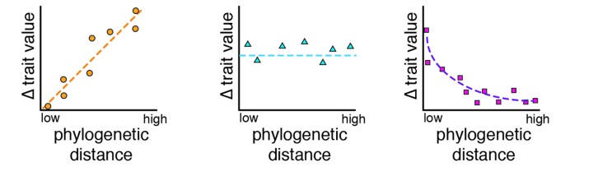
Phylogenetic autocorrelation
Positive Phylogenetic Autocorrelation
Evolutionary similarity means similar traits
No Phylogenetic Autocorrelation
Evolutionary similarity does not affect trait similarity
Negative Phylogenetic Autocorrelation
Evolutionary Similarity means different traits

Slide 50
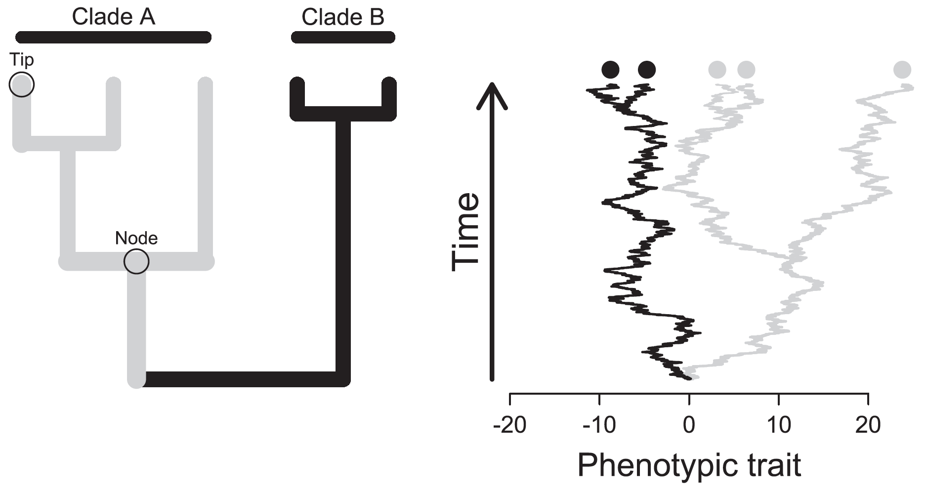
Phylogenetic autocorrelation
The correlation between species/nodes is determined by evolutionary:
Tempo
Amount of change per unit time
Mode
mechanisms responsible for evolution and their patterns

Slide 51
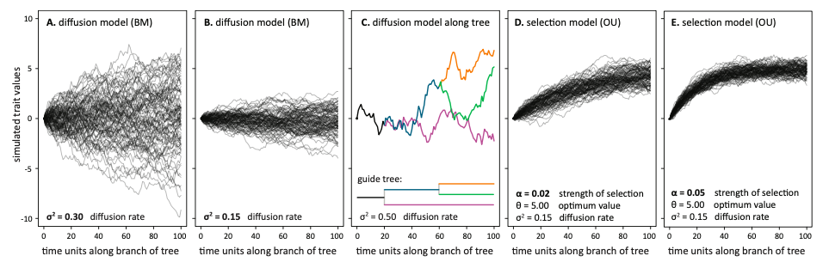
Phylogenetic autocorrelation Models of evolution
Brownian motion
Random drift and constant rate
through time and across lineages
Ornstein–Uhlenbeck
Changes got towards a fitness optimum on an adaptive landscape

Slide 52
Phylogenetic autocorrelation R – implementation [Brownian]
Phylogeny
corBrownian(phy)
corPagel(value, phy)
Phylogeny
value of the parameter λ
λ=Phylo Signal

Slide 53
Phylogenetic autocorrelation R–implementation [Ornstein–Uhlenbeck]
corMartins(value, phy)
Phylogeny
value of the parameter α
α=optima

Slide 54
So far so good?
Any questions?
Ready to move on?

Slide 55
Model Selection – two steps
Model selection is done in two stages:
Define the best variance/correlation structure.
Comapre a full model in fixed effects to one with a given variance/correlation structure.
Full and variance/correlation model are fitted using “REML”
Define the best fixed structure.
Reduce the pool of fixed effects from the model selected above
Models beeing reduced are build using “ML”.

Slide 56
Model Selection –step-1
Define the best variance/correlation structure
B1A<- gls(A ~ towns + region + Sex, data= eire.Dat,
correlation=corSpher(form=~x + y, nugget=TRUE),
method = ‘REML’)
B1B<- gls(A ~ towns + region + Sex, data= eire.Dat,
correlation=corLin(form=~x + y, nugget=TRUE) ,
method = ‘REML’)
B1C <- gls(A ~ towns + region + Sex, data= eire.Dat,
correlation=corRatio(form=~x + y, nugget=TRUE) ,
method = ‘REML’)
B1D <- gls(A ~ towns + region + Sex, data= eire.Dat,
correlation=corGaus(form=~x + y, nugget=TRUE) ,
method = ‘REML’)
B1E <- gls(A ~ towns + region + Sex, data= eire.Dat,
correlation=corExp(form=~x + y, nugget=TRUE) ,
method = ‘REML’)
One note of model Selection
If you need to include and the explanation of the (co)variance it is more important to have an expectation of it in you model that finding the “best” description.

Slide 57
Model Selection –step-1
Define the best fixed structure.
B1EFull <- gls(A ~ towns + region + Sex, data= eire.Dat,
correlation=corExp(form=~x + y, nugget=TRUE) ,
method = ‘ML’)
B1EMod1 <- gls(A ~ towns + region, data= eire.Dat,
correlation=corExp(form=~x + y, nugget=TRUE) ,
method = ‘ML’)
B1EMod2 <- gls(A ~ towns + Sex, data= eire.Dat,
correlation=corExp(form=~x + y, nugget=TRUE) ,
method = ‘ML’)
B1EMod3 <- gls(A ~ region + Sex, data= eire.Dat,
correlation=corExp(form=~x + y, nugget=TRUE) ,
method = ‘ML’)

Slide 58
Restricted Maximum Likelihood (REML) Maximum Likelihood (ML) Analysis
Maximum Likelihood (ML) Analysis
Focused on getting the coefficients of the linear model right.
That is the focus is predicting the mean correctly.
Restricted Maximum Likelihood (REML)
Focused on getting the variances in the model right.
That is the focus is predicting the variance correctly.
A good explanation of the diff between these is here:
https://towardsdatascience.com/maximum-likelihood-ml-vs-reml-78cf79bef2cf

Slide 59
So far so good?
Any questions?
Ready to finish?

Slide 60
In summary
Generalized Least Squares is an approach that allows controlling for:
Heterogeneous variances: via modelling the variance using multiple strategies.
Autocorrelated Variables: Via the inclusion of correlation structures
Autoregresing / moving averages
Semivarigram/correlogram
Phylogenetic relatedness

Slide 61
In summary
Model selection in mixed models is a two step process:
Part one – define the best variance/covariance structure
Models build using REML
Part two – define the best fixed effect structure
Models build using ML

